Slide 1
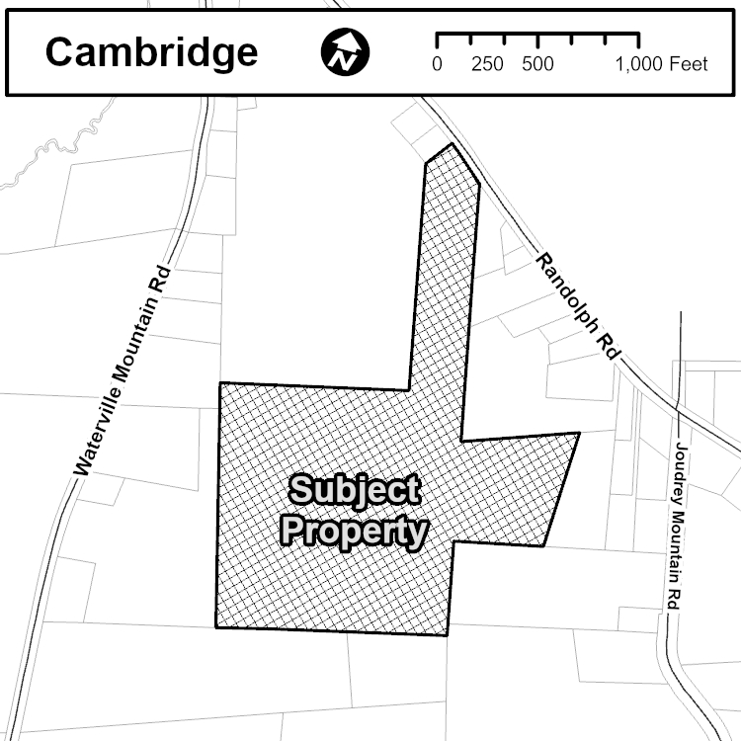

Public Information Meeting
Land use by-law map amendment at 867 Randolph Rd (PID 55358485), Cambridge
Applicant: Kyle Garden of Dropline Properties Inc
Chair: Councillor Emily Lutz

Slide 2

Purpose of the Meeting
To inform the public of the application.
To explain the planning policies that enable this application to occur.
To receive preliminary feedback.
No opinions have been formed on this application, and no decisions will be made tonight.
Municipal Council will make the final decision through a majority vote at a later date.
The meeting is not recorded; no minutes will be taken.
Planner will take notes of the comments and feedback.

Slide 3
We value open communication and encourage respectful discussion.
The Municipality is committed to providing a safe and respectful space for staff and our attendees.
Abusive actions and language will not be tolerated and may result in the termination of the meeting to protect the well-being of all involved.

Slide 4
Public Information Meeting
Land use by-law map amendment at 867 Randolph Rd (PID 55358485), Cambridge
Alice Jacob
Planner
Planning Services
September 24, 2025

Slide 5
1. Complete Application Received
2. Public Information Meeting (PIM)
LUB Map Amendment
3. Staff Review
4. Planning Advisory Committee(PAC)
Properties within 500 feet were notified of the Public Information Meeting
Properties within 500 feet will be notified of the Public Hearing
5. First Reading
6. Public Hearing (PH)
7. Second Reading
8. 14-day appeal period
Notes:
This is the process the application will undergo before Council makes a final decision.
We received the application in August, xxxxx.
Staff will review the application and will prepare a report with a recommendation.
The report will be presented to the Planning Advisory Committee, and the committee may forward it to Council for First Reading.
Council may then schedule a public hearing.
properties within 500 feet will be notified of the hearing.
After the hearing, the application will go back to council for a second reading, followed by a 14-day appeal period

Slide 6
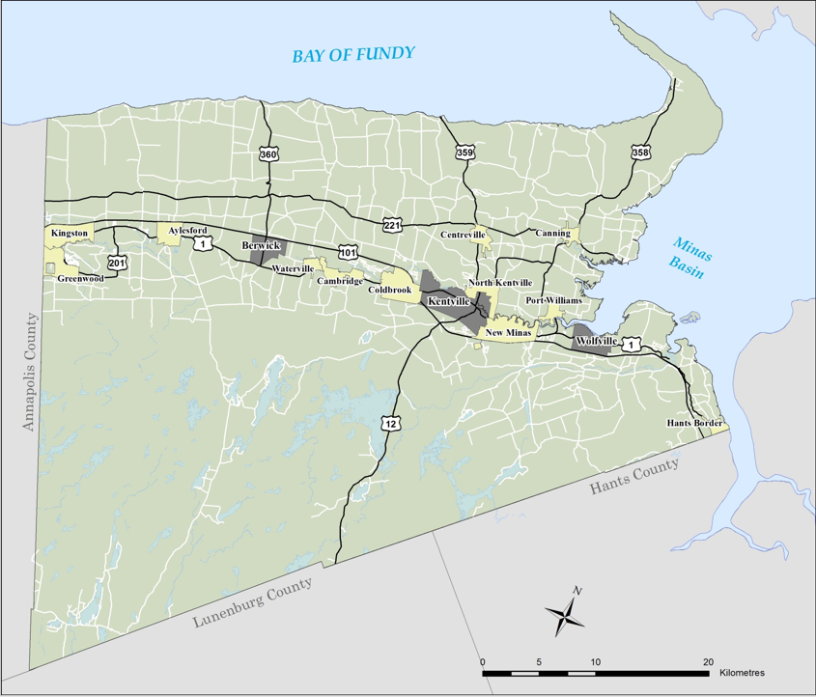
Location
867 Randolph Rd (PID 55358485), Cambridge

Slide 7
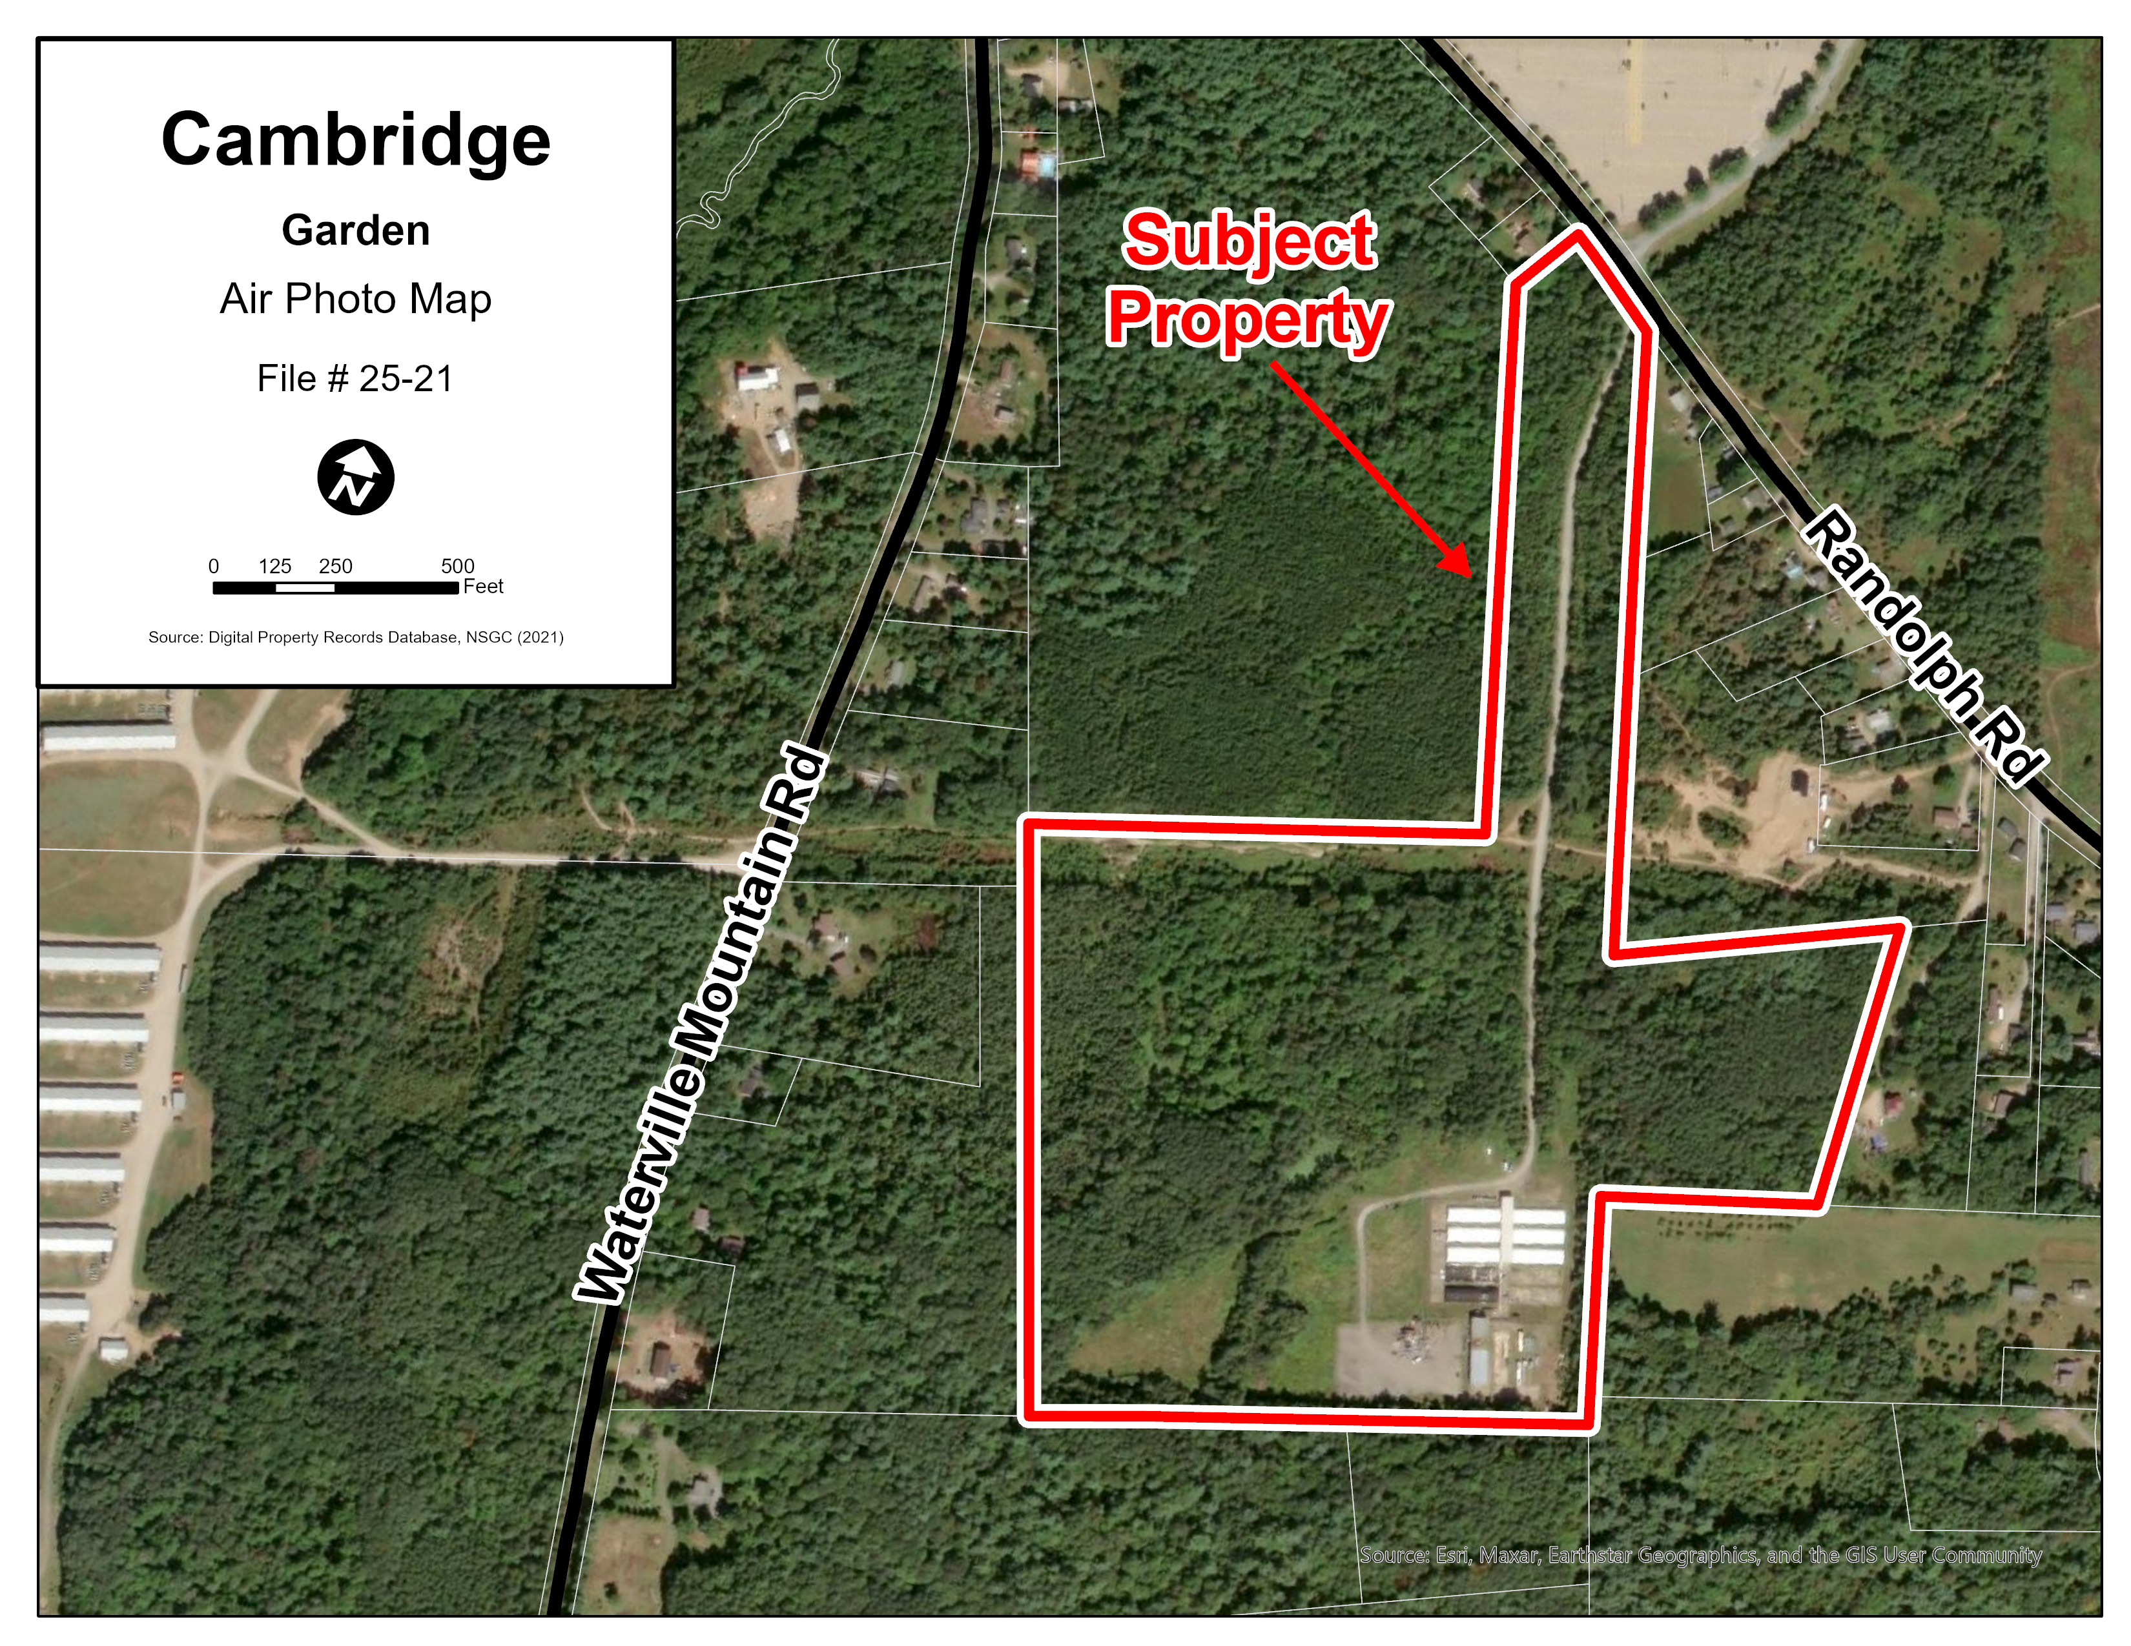
Slide Title
Text
Text
Text
Notes:
32 acres
Randolph Road
Developed with a storage units and a business office

Slide 8
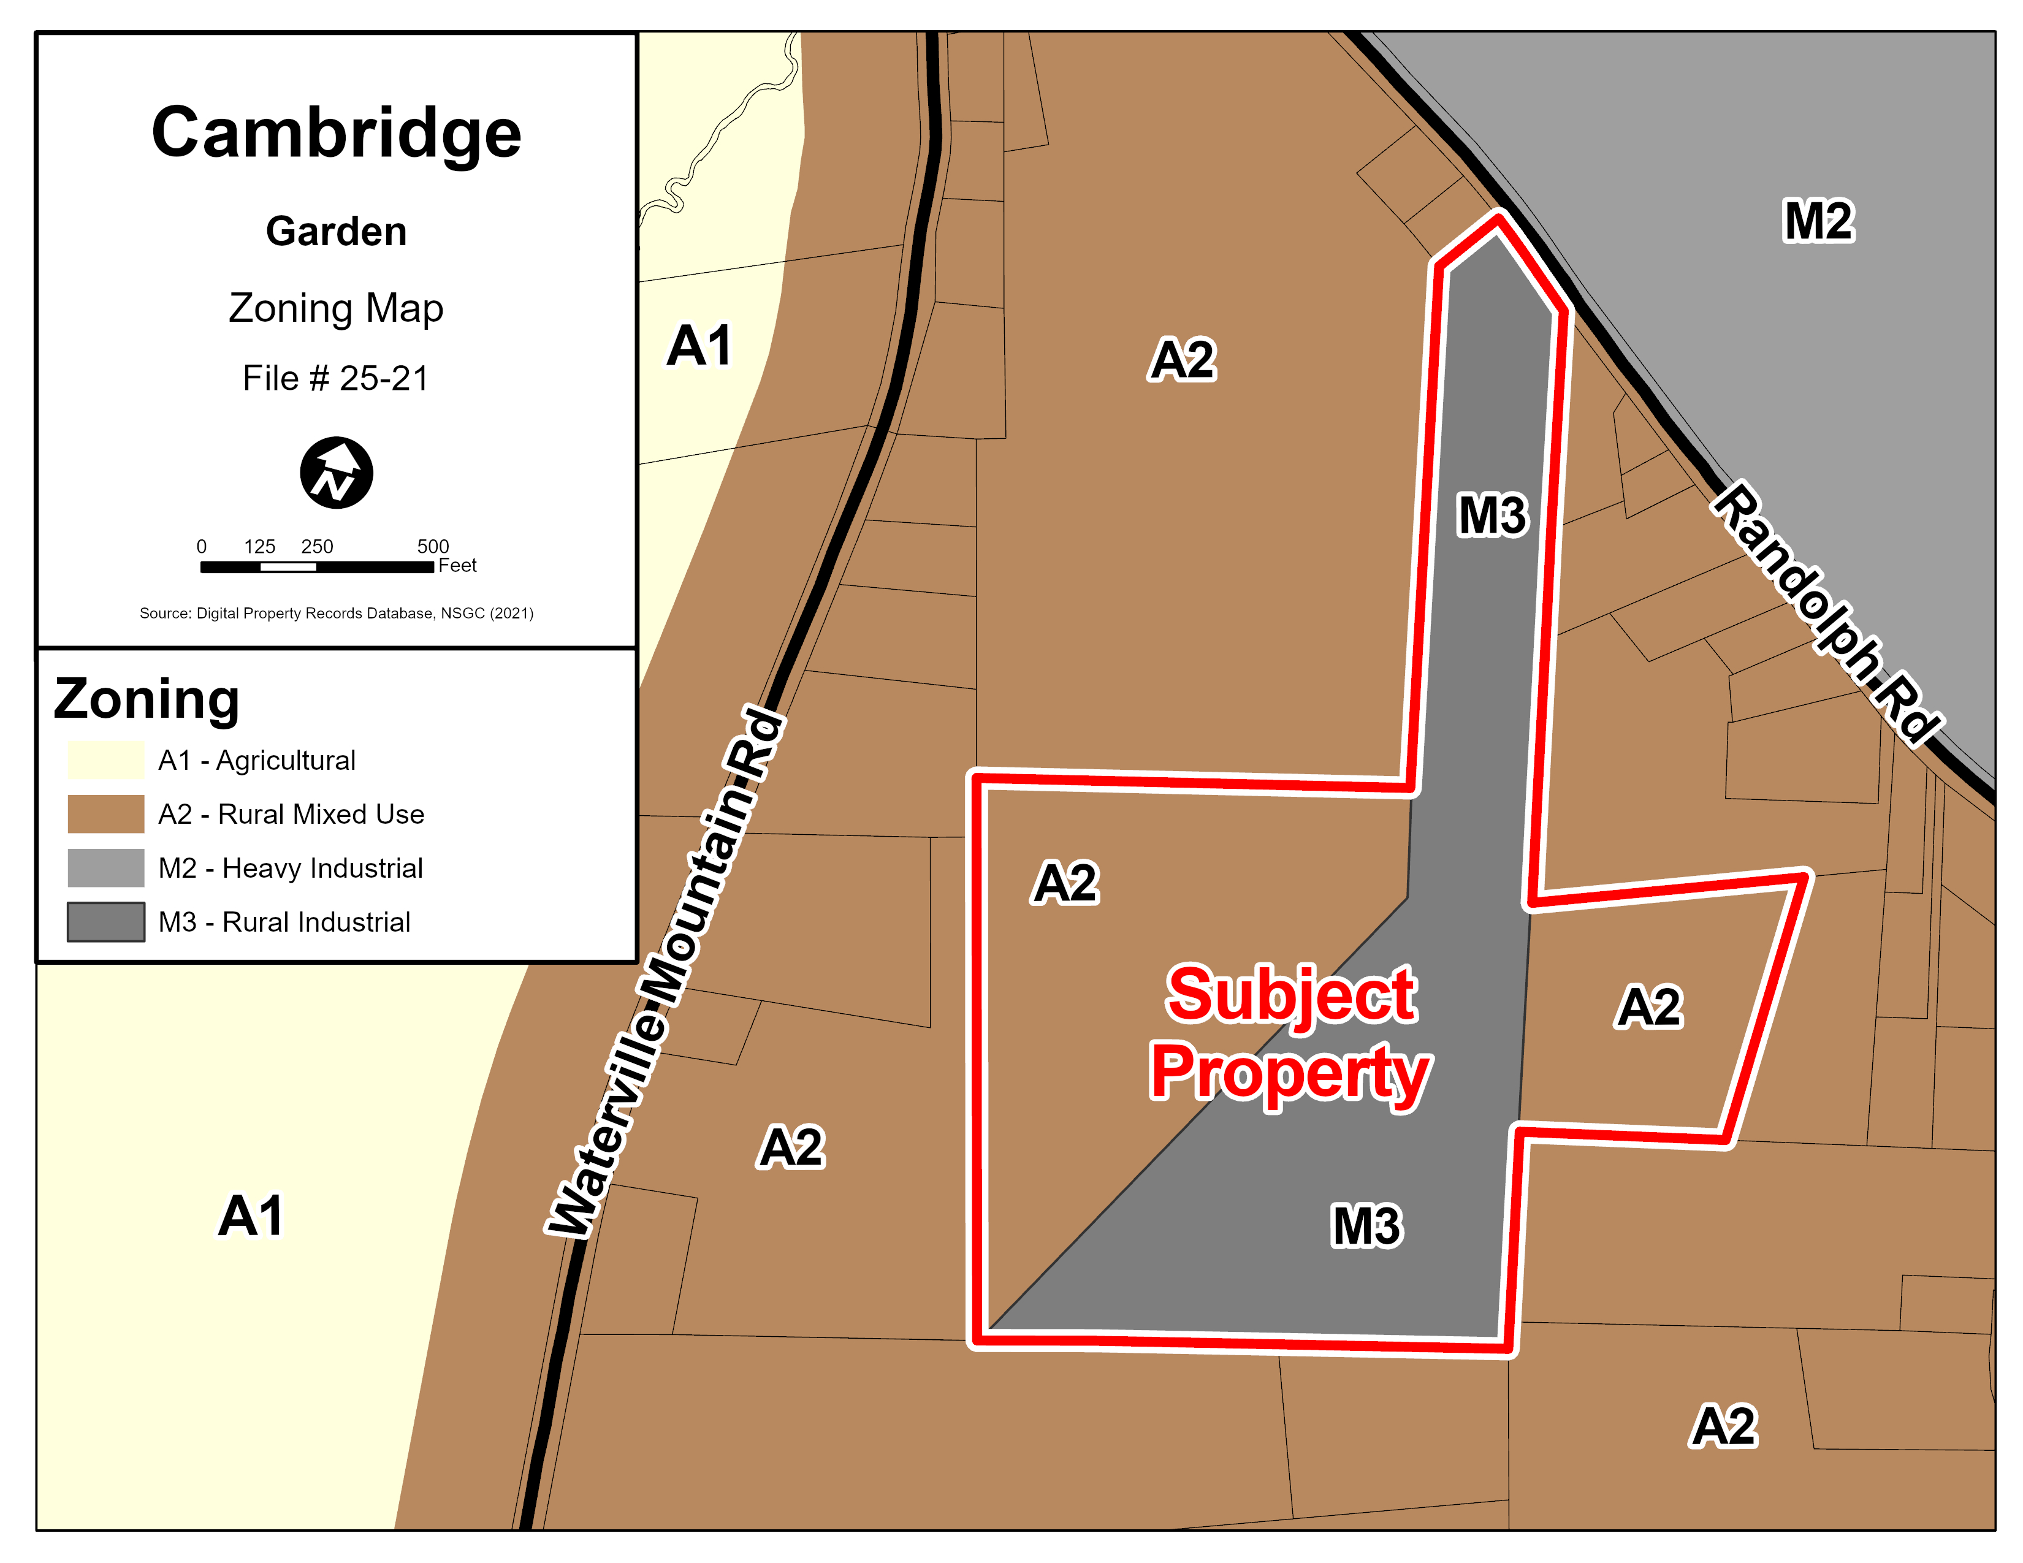
Proposal
Eastern portion vacant
Zoned Rural Mixed Use (A2)
Proposal to develop self-storage units
A2 zone does not permit self-storage facility
Rezoning to Rural Industrial (M3)
Notes:
The eastern portion, in a dashed yellow line, is vacant
The portion is zoned Rural Mixed Use – A2 Zone
Applicant intends to develop a self-storage facility
But the A2 zone does not permit self storage facility
Request is to rezone it to another zone called the Rural Industrial to permit the self storage facilities

Slide 9
Proposal
Eastern portion vacant
Zoned Rural Mixed Use (A2)
Proposal to develop self-storage units
A2 zone does not permit self-storage facility
Rezoning to Rural Industrial (M3)
M3
Notes:
The eastern portion, in a dashed yellow line, is vacant
The portion is zoned Rural Mixed Use – A2 Zone
Applicant intends to develop a self-storage facility
But the A2 zone does not permit self storage facility
Request is to rezone it to another zone called the Rural Industrial to permit the self storage facilities

Slide 10
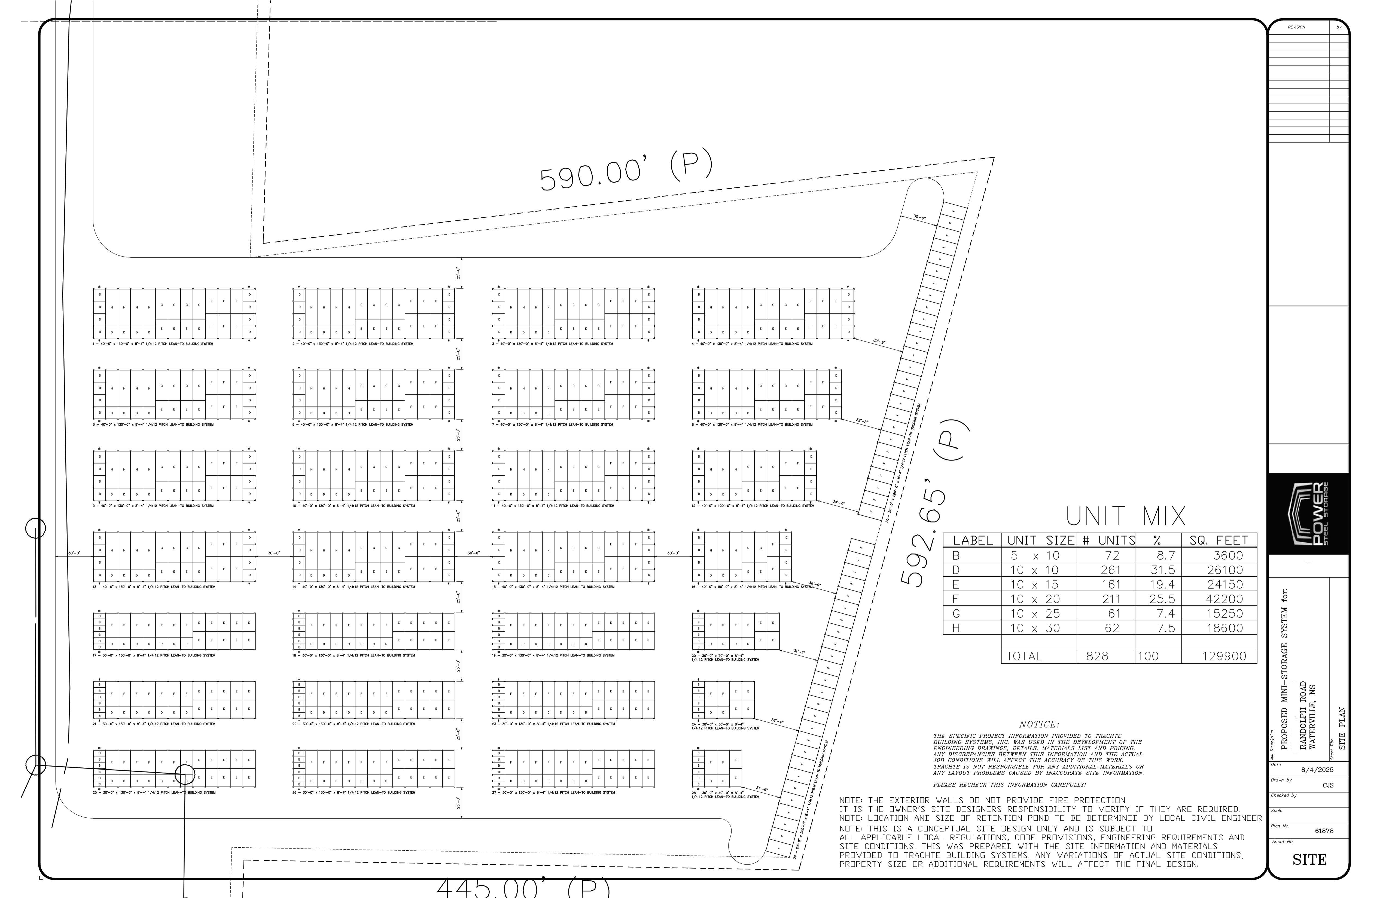
Text
Text
Text
Notes:
Approximately 800 units

Slide 11
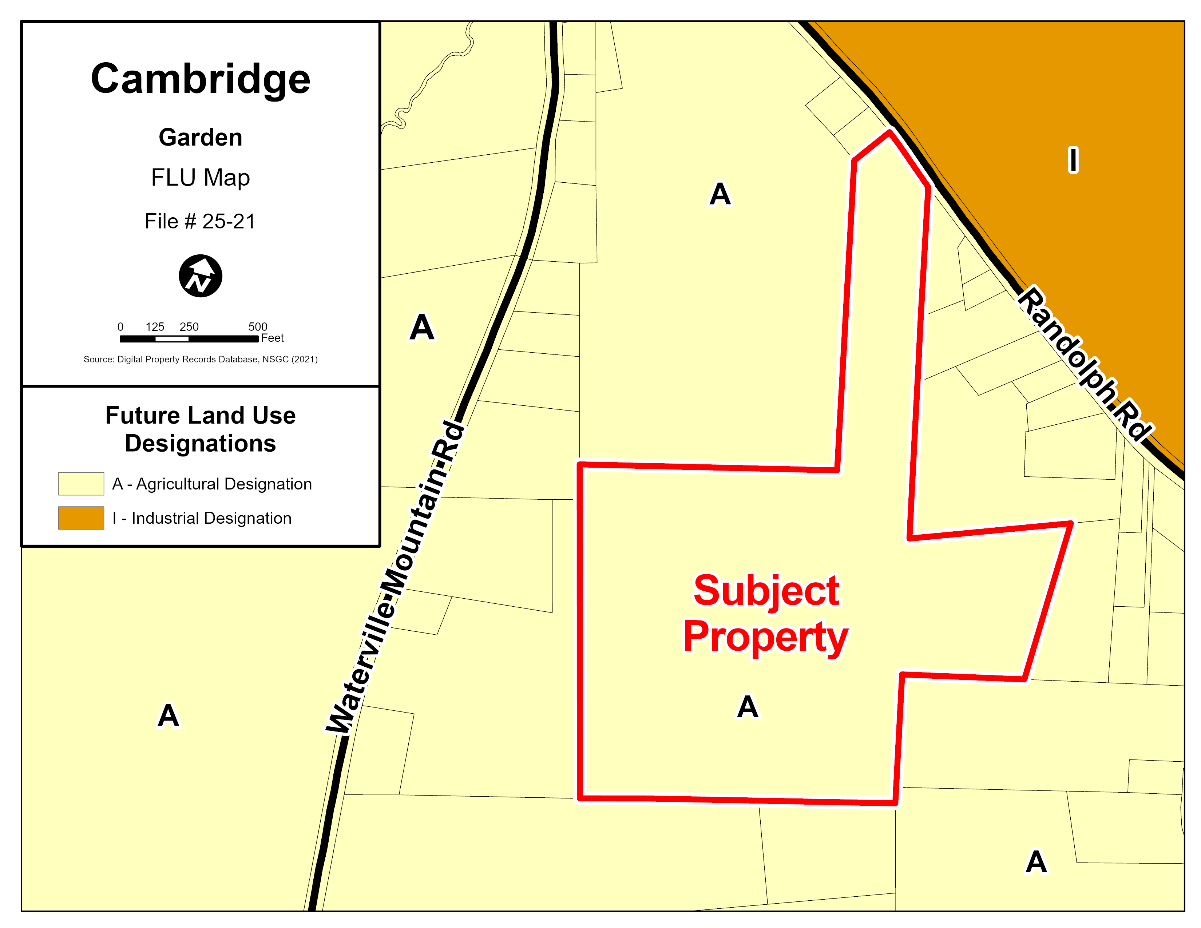
Slide Title
Text
Text
Text
Notes:
Land use designation of the area
The designation determines which zones and types of uses can be permitted in the area
The property is within the agricultural designation
Both the current zoning and the proposed zoning are permitted within the designation
Which, in short, means it enables Council to consider this rezoning

Slide 12
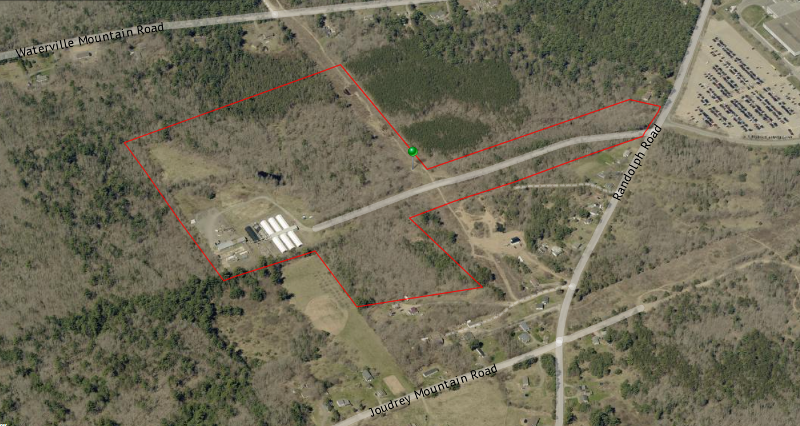
Text
Text
Text
Notes:
Subject property and the neighbouring uses
Residential
Michelin tire plant

Slide 13
Enabling Policy
Policies 2.2.12 and 3.4.23 enable Council to consider rezoning land from the Rural Mixed Use (A2) Zone to the Rural Industrial (M3) Zone, given the proposal meets a few policy criteria

Slide 14
Enabling Policy
It has to be land that has not been in recent agricultural production
The proposal wouldn’t rezone more land than required
The proposal will not create undue conflict with nearby agricultural or rural residents
Proposal meets the general criteria
Notes:
These are the criteria the proposal will need to meet:
Council has to be satisfied that the proposal
is not on a land that has been in recent agricultural production
That it wouldn’t rezone more land than required
That it will not create any undue conflict with nearby agricultural or rural residents
And that it meets the general criteria

Slide 15
Additional Policy
Policy 5.3.5 provides additional policy directions for rezonings
  Is the proposal consistent with the proposed zone’s zone placement polices?
  Are the impacts of the proposed use and other permitted uses within the zone acceptable?
  Does it meet the general criteria?
Notes:
Whether the proposal is consistent with the proposed zones placement policies
Whether the impacts of the proposed use and other permitted uses are appropriate
Whether it meets the general criteria

Slide 16
General Criteria
MPS Policy 5.3.7 – General Criteria | Assessing Authority
The intent of the Municipal Planning Strategy | Municipality
Does the proposal conflict with any Municipal/Provincial programs, By-Laws, or regulations | Municipality
Financial Impact on the Municipality/Village | Municipality/ Village of Cornwallis Square
Land use compatibility | Municipality
Creation of traffic hazards or congestion | NSDPW (Provincial)
Adequacy of fire protection services and equipment | Waterville Fire Dept.
Adequacy of sewer and water services | NSECC (Provincial)
Potential for flooding or serious drainage problems | Municipality
Potential for pollution in the area | Municipality
Negative impacts on neighbouring farm operations | Municipality
Site suitability | Municipality
Notes:
This is the general criteria which requires us to look into various aspects such as the proposal's consistency with the Municipal Planning Strategy, the compatibility with surrounding uses, financial impacts, adequacy of fire protection services, adequacy of sewer and water services, and various other aspects. Most of these will be reviewed by us, the municipality, but there are a few that are not within our jurisdiction, and we would reach out to the relevant departments for their feedback.

Slide 17
1. Complete Application Received
No decisions will be made tonight
2. PIM
3. Staff Review
4. Planning Advisory Committee
5. First Reading
Municipal Council makes the final decision
6. Public Hearing
7. Second Reading
8. 14-day appeal period
Notes:
Recap of the process
We will not be making any decisions tonight
Feedback and comments

Slide 18
Questions and Comments
Please stand up and provide your name and address before you speak
Meeting is not recorded, planner takes notes of comments
Only comments linking back to Planning Policy may be considered for decision-making
Attendees are requested to maintain a respectful environment
Notes:
Some quick notes before we move on to the questions and comments

Slide 19
Questions and Comments
Alice Jacob, Planner
Planning and Development Services
Municipality of the County of Kings
902-690-6276
ajacob@countyofkings.ca

